Slide 1
Encore Tickets
Humberto Arana, Zain Husain, Michael Lyke, Keaton May
April 23, 2019

Slide 2
Business Overview
Encore Tickets allows customers to:
Browse lists of:
Performers
Events
Venues
Tickets
Purchase tiered tickets
Purchase add-ons
Register to a membership

Slide 3
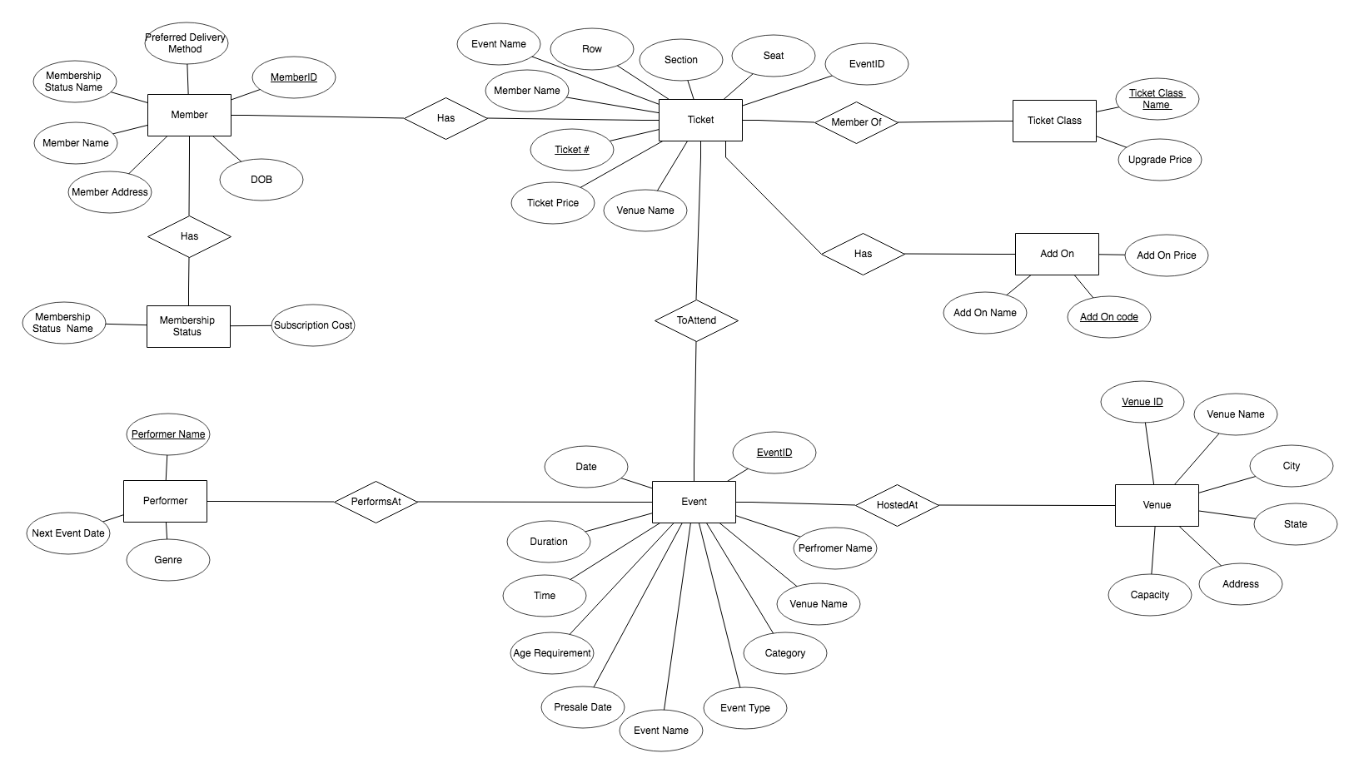
Datamodel

Slide 4
Demonstration

Slide 5
Problems and Solutions
Data generation
Thought we could automate, but were unable too
Ended up writing out all data and insert statements by hand
Queries
Kept generating spurious tuples
Tried a few different statements and found the ones that worked
Insertions
Getting errors
Had to go through all hand written insertions and eventually found the errors

Slide 6
Next Level Funding
By 2023 the worldwide ticket industry will:
Be a $105 Billion Market [1]
Be used by 1.1 Billion Customers [1]
In the US alone: 8.3% annual growth [2]
Expanding Encore Tickets to accommodate Cinematic and Sports events will increase revenue.

Slide 7
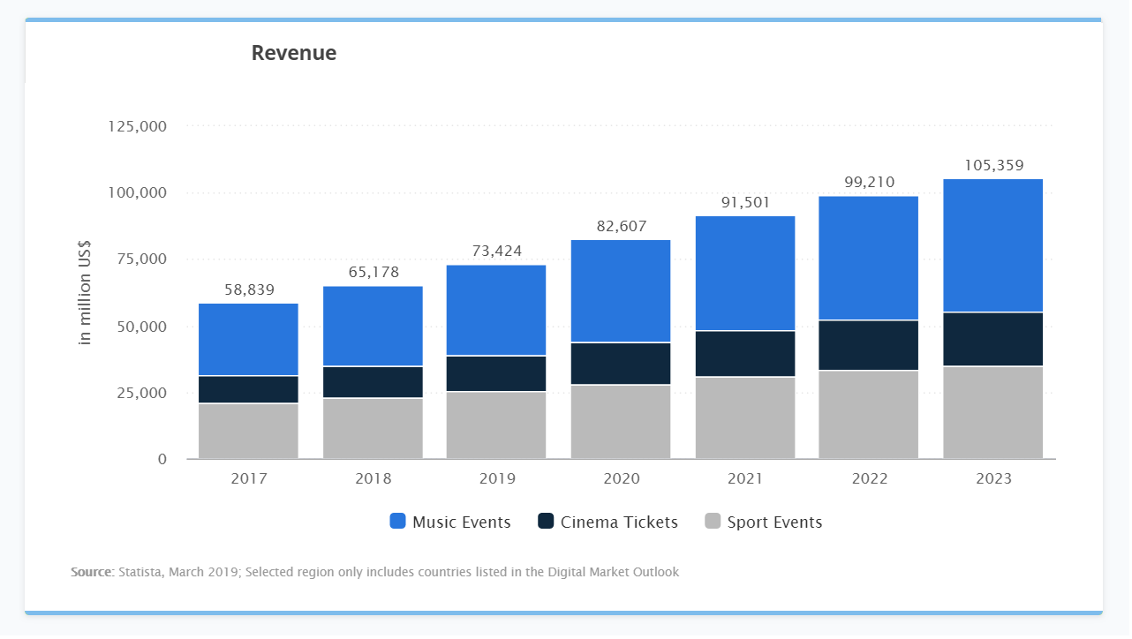
[1]

Slide 8
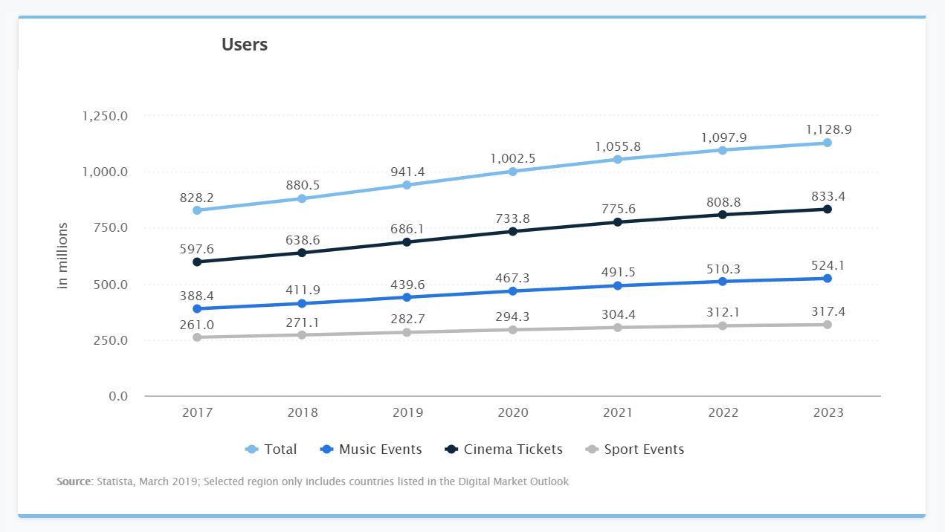
[1]

Slide 9
Conclusion

Slide 10
References
[1] “Event Tickets Worldwide” (statista) [Online]. Available: https://www.statista.com/outlook/264/100/event-tickets/worldwide (Accessed: April 17, 2019).
[2] “Online Event Ticket Sales Industry in the US,” (ibisworld) [Online]. Available: https://www.ibisworld.com/industry-trends/specialized-market-research-reports/online-retail/lifestyle-services/online-event-ticket-sales.html (Accessed: April 18, 2019).

